Slide 1
Fuzzy Neural Network
By Daniel Elstob
14011862

Slide 2
Neural Networks
Simplified Mathematical model of brain-like systems
Is not programmed, but is trained
Supervised Learning
Given training data and desired response
Unsupervised Learning
Given training data but no desired response
Notes:
Mathematical models of a biological brain’s neural network and should be able to produce similar responses and behaviours as their biological counter parts.
Both biological and artificial networks have neurons which work by processing information and are joined with synapses to form networks. These neurons are what dictate the leaning and in artificial neural networks this refers to the method of modify the weights of the synapses. The overall learning ability of the network is determined by the learning style chosen for training and the architecture of the network.
There are two learning styles which can be used which are supervised learning and unsupervised learning.
Supervised learning is where the network is given training data sets and desired response. Once it has completed the learning process they can be used on new data sets to find the desired response. They are often used within the fields of robotics, pattern recognition and prediction systems and with a variety of network types they can be applied to many more problems such as the medical field for drug discovery or financial application for algorithmic trading.
Unsupervised learning is essentially learning by doing in which no desired response is provided but training data sets are still given. This causes methods like clustering to be used where the network tries to categorise data by their similarities. This makes unsupervised learning methods useful for data mining of large data such as in the medical field or object recognition within computer vision applications.

Slide 3
Fuzzy Logic
It is a rule based systems first introduced by Lotfi Zadeh (Zadeh 1965)
Created to model human reasoning processes
A means of representing data that is not precise - approximate reasoning
Consists of fuzzy sets and fuzzy rules

Slide 4
Fuzzy Sets
Allow us to
model concepts and objects in the real world
deal with situations that are not precise
Real world decisions contain high levels of uncertainty
Fuzzy sets are a collection of related items which belong to that set to different degrees
Notes:
Fuzzy sets allow us to model concepts and objects in the real world and to deal with situations that are not precise.
For example it can describe the weather as hot without using precise numbers.
Real world decisions contain high levels of uncertainty which need to be taken into account.
Fuzzy sets are a collection of related items which belong to that set to different degrees.
A basketball team is a set and the player are the items in the set, if you want to find out who is tall, you can set that anyone over a certain height is and if they are shorter they are classified as not tall. If you apply fuzzy logic you can say that all players are tall to a certain degree which gives much more detail about the items in the set.

Slide 5
Fuzzy Rules
Can be thought of as common sense rules
In rules we use worlds rather that numbers to describe items
Take partially true facts and find out to what degree they are true
then take another fact making it true to that degree
A number of rules can then be combined and a decision can be made
This whole process is called inference
Notes:
Rules use human concepts not strict measurements and can be thought of as common sense rules.
In rules we use worlds rather that numbers to describe items.
Fuzzy rule take partially true facts such as a person is tall or their agility and finds out to what degree they are true
then takes another fact making it true to that degree for example how tall a person should be for a certain sport, if a person is tall and agile then consider basketball is short and broad they should consider wrestling.
A number of rules can then be combined and a decision can be made.
This whole process is called inference.
Knowledge is represented by fuzzy sets combed using fuzzy rules and when all of this information is considered a decision can be made.

Slide 6
Characteristics of Fuzzy Logic
Exact reasoning is viewed as a limiting case of approximate reasoning
Everything is a matter of degree
Knowledge is interpreted as a collection of fuzzy constraints on a collection of variables
Inference is viewed as a process of propagation of constraints
Any logical system can be fuzzified

Slide 7
Characteristics of Fuzzy Systems
Fuzzy systems are suitable for uncertain or approximation reasoning
Fuzzy logic allows decision making with estimated values under incomplete or uncertain information
Notes:
Two main characteristics of fuzzy systems that give them better performance for specific application
especially for the system with a mathematical model that is difficult to derive

Slide 8
Strengths and Weaknesses
Fuzzy Systems are good at:
Knowledge Representation
Uncertainty Tolerance
Imprecision Tolerance
Lack the ability:
To Learn
Discover Knowledge
Neural Networks are good at:
Dealing with raw data
Learning and Adapting
Knowledge Discovery
Data Mining
Lack the ability:
Knowledge Representation
Explanation Ability
Notes:
A fuzzy system is good at things like knowledge representation, uncertainty tolerance and imprecision tolerance however it lacks the ability to learn and discovery knowledge.
Neural networks are good at dealing with raw data and have the ability to learn and adapt as well as knowledge discovery and data mining. Unlike a fuzzy system they are bad at knowledge representation and explanation ability.

Slide 9
Fuzzy Neural Networks
Combination of Fuzzy Logic and Neural Networks
Combines the
knowledge discovery and learning abilities of neural networks
knowledge representation and explanation abilities of fuzzy systems
Created to combine
Interpretability of Fuzzy Systems
Mapping precision and automation of Neural Networks
Combines both such that either
Fuzzy System give input to Neural Network
Neural Network give input to Fuzzy System
Notes:
And this is where the idea of fuzzy neural networks comes from.
The combination of fuzzy logic and neural networks constitutes a powerful means for designing intelligent systems which combines the knowledge discovery and learning abilities of neural networks with the human-like knowledge representation and explanation abilities of fuzzy systems.
This causes the neural networks to become much more translucent, whilst the fuzzy systems are able to learn.
Interpretability means the relation between formal theories that expresses the possibility of interpreting or translating one into the other
Combines both such that either:
Fuzzy system gives input to Neural Network
Neural Network give input to Fuzzy Systems

Slide 10
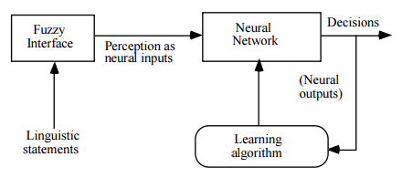
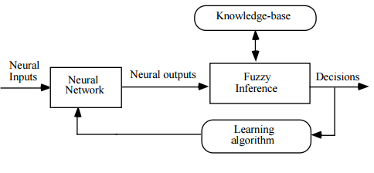
Fuzzy System to Neural Network
Neural Network to Fuzzy System
Fuzzy Neural Systems models (Fuller, 1999)
Notes:
Two possible models of fuzzy neural systems are
Fuzzy system gives input to Neural Network
• In response to linguistic statements, the fuzzy interface block provides an input vector to a multi-layer neural network. The neural network can be adapted (trained) to yield desired command outputs or decisions.
Neural Network give input to Fuzzy Systems
• A multi-layered neural network drives the fuzzy inference mechanism

Slide 11
Research Areas
Bankruptcy (Vlachos and Tolias, 2003), (Kumar and Ravi, 2006) (Purvinis et al, 2008), (Zanganeh, Rabiee and Zarei, 2011), (Arora and Saini, 2013), (Karamzadeh, 2013) and (Arora and Saini, 2014)
Algorithmic Trading(Doumpos, Zopounidis, and Pardalos, 2012) and (Vella and Ng, 2014)
Education Systems (Saber Iraji et al., 2012), (Inyang and Joshua, 2013), (Arora and Saini, 2013) and (Do and Chen, 2013).
Notes:
A newer area to research is education where fuzzy systems are being developed to classify students and predict their academic performance
Handwriting recognition
Automotive systems and manufacturing
Image processing and data compression
Architecture
Decision-support systems
Power systems

Slide 12
References
Fullér, R. (1999). Fuzzy logic and neural nets in intelligent systems. Information Systems Day.–Turku Centre for Computer Science, Åbo, 17, 74-94.
Vlachos, D. and Tolias, Y. (2003). Neuro-fuzzy modeling in bankruptcy prediction. Yugosl. j. oper. res., 13(2), pp.165-174.
Kumar, P., R. and Ravi, V. (2006) Bankruptcy prediction in banks by fuzzy rule based classifier. In: Proceedings of the 2006 first international conference on digital information management. pp. 222–227.
Purvinis, O., Virbickaite, R., & Sukys, P. (2008). Interpretable nonlinear model for enterprise bankruptcy prediction. Nonlinear Analysis: Modelling and Control,13(1), pp. 61-70.
Zanganeh, T., Rabiee, M. and Zarei, M. (2011). Applying Adaptive NeuroFuzzy Model for Bankruptcy Prediction. International Journal of Computer Applications, 20(3), pp.15-21.
Karamzadeh, M.S. (2013). Application and comparison of Altman and Ohlson models to predict bankruptcy of companies, Research Journal of Applied Sciences, Engineering and Technology, 5(6), pp. 2007-2011
Arora, N. and Saini, J.R. (2013). Time series model for bankruptcy prediction via adaptive neuro-fuzzy inference system, International Journal of Hybrid Information Technology, 6(2), pp. 51-64.
Arora, N. & Saini, J.R. (2014). Bankruptcy Prediction of Financially Distressed Companies using Independent Component Analysis and Fuzzy Support Vector Machines, International Journal of Research in Computer and Communication Technology, 3(2), pp. 924-931.
Doumpos, M., Zopounidis, C., and Pardalos, P. M. (2012). Financial decision making using computational intelligence (Vol. 70). Springer Science & Business Media.
Vella, V. and Ng, W., L. (2014). Enhancing risk-adjusted performance of stock market intraday trading with Neuro-Fuzzy systems. Neurocomputing 141. pp. 170-187.
Saber Iraji, M., Aboutalebi, M., Seyedaghaee, N. and Tosinia, A. (2012). Students Classification With Adaptive Neuro Fuzzy. IJMECS, 4(7), pp.42-49.
Inyang, U. and Joshua, E. (2013). Fuzzy Clustering of Students’ Data Repository for At-Risks Students Identification and Monitoring. Computer and Information Science, 6(4).
Do, Q. and Chen, J. (2013). A Neuro-Fuzzy Approach in the Classification of Students’ Academic Performance. Computational Intelligence and Neuroscience, 2013, pp.1-7.

Slide 13
Brain Computer Interfaces
By Daniel Elstob
14011862

Slide 14
What is BCI
Mak and Wolpaw define BCI as “a communication and/or control system that allows real-time interaction between the human brain and external devices” (Mak and Wolpaw, 2009)
Four key elements of BCI (Wolpaw et al., 2002)
Signal Producing
Signal Detection
Signal Processing
Signal Transduction
Notes:
Signal Production
Brain signals need to be produced by the subject in order to be used. These signals could be the brain waves that are already generated subconsciously, which can be harder to detect, or to actively generate the signal through stimuli which the subject would have control over and could increase the strength through concentration.
Signal Detection
There are various ways to detect the necessary signals. The most popular approaches are ElectroEncephaloGraph (EEG) which is for brain signal, ElectroMyoGraph (EMG) which is for muscles and Functional Magnetic Resonance Imaging (fMRI) which is used to measure the blood flow in the brain. Some other less popular approaches are MagnetoEncephaloGraphy (MEG) and ElectroCorticoGraphy (ECoG). Depending on the purpose of detecting the signals each approach will have its strengths and weaknesses such as better temporal resolution or spatial resolution.
Signal Processing
One of the major problems of from signal detecting is that a lot of noise is produced. For example when using EEG things like eye movement and facial reactions will be included in the data. This is where signal processing is used to filter the excess noise out of the data you have collected so that the data can be used for detecting actual brain signals.
Signal Transduction
Once you have detected the desired signals in your data, you can use them. For example the subject could for example use the BCI to control the movement of a robot, assignment the movement of a limb to a direction the robot can move in. However an issue you will encounter here is that you need to use the data as efficiently as possible, whilst understanding that that BCI's can make mistakes. Current BCI's can be slow and make mistakes about distinguishing different brain signals.

Slide 15
Types of BCI
Invasive
Surgically implanted into the brain
Applications : treat acquired blindness (Dobelle, 2000) and paralysis (Birbaumer, Murguialday and Cohen, 2008)
Non-invasive
Non-surgical approach (headsets) (Pfurtscheller et al., 2003)
Partially Invasive
Surgically implanted inside the skull
Notes:
Invasive BCIs are surgically implanted directly into the brain. This gives them the best signal quality however as a foreign object the body will react to it causing scar tissue build up which weak the signal or cause it to become non-existent. These types of BCI are used to assist or treat individuals with paralysis (Birbaumer, Murguialday and Cohen, 2008) or acquired blindness (Dobelle, 2000).
Non-invasive BCIs are a non-surgical approach of reading signals from outside the head the signals are much weaker as they have to pass through the skull. This approach would use EEG to control external devices or prosthetics (Pfurtscheller et al., 2003).
Partially invasive BCIs are, like invasive, surgically implanted inside the skull but unlike invasive they are outside of the brain. This gives them a midpoint between invasive and non-invasive. They produce better signal that non-invasive BCIs as the signals do not have to pass through the skull before being received and because they are not implanted into tissue they are less likely to form scar tissue. Yanagisawa showed that this approach could be useful to those with motor disabilities like lock-in syndrome using ECoG (Yanagisawa et al., 2011).

Slide 16
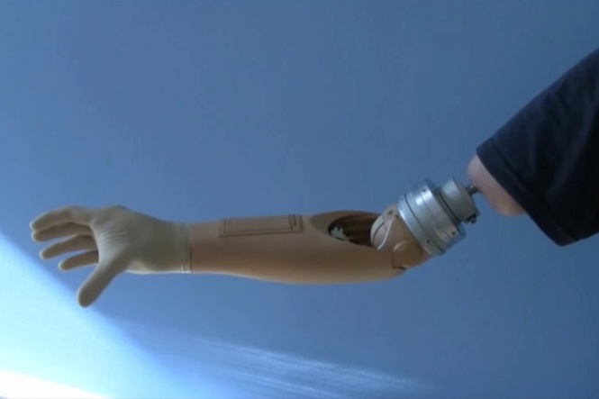
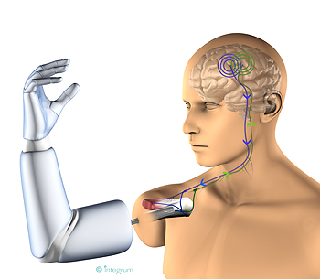
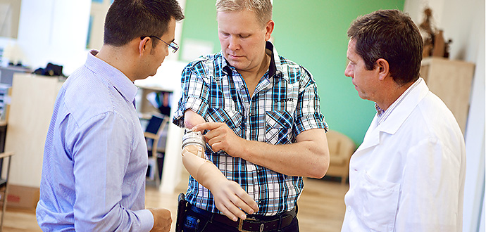
Osseointergrated Prosthetic
First implant with electrodes directly into muscles and nerves
Titanium implant into bone
Component attached to implant
Prosthetic to component
Implanted Prosthetic (above) (Chalmers University of Technology, B., 2014)
Visual Representation (below).
(Chalmers University of Technology, C ., 2014)
Max Oritz Catalan (left), Magnus Niska (center) and Rickard Brånemark (right). (Chalmers University of Technology, A., 2014)
Notes:
This is the first implanted arm with electrodes integrated directly into the muscles. They are currently testing tactile feedback with the arm, meaning that Niska will eventually be able to feel sensory input through the arm.
More about: How the technology works The new technology is based on the Opra treatment (osseointegrated prosthesis for the rehabilitation of amputees), where a titanium implant is surgically inserted into the bone and becomes fixated to it by a process known as osseointegration (osseo = bone). A percutaneous component (abutment) is then attached to the titanium implant to serve as a metallic bone extension, where the prosthesis is then fixated. Electrodes are implanted in nerves and muscles as the interfaces to the biological control system. These electrodes record signals which are transmitted via the osseointegrated implant to the prostheses, where the signals are finally decoded and translated into motions.
Nerve impulses from the brain control the Chalmers University prosthesis

Slide 17
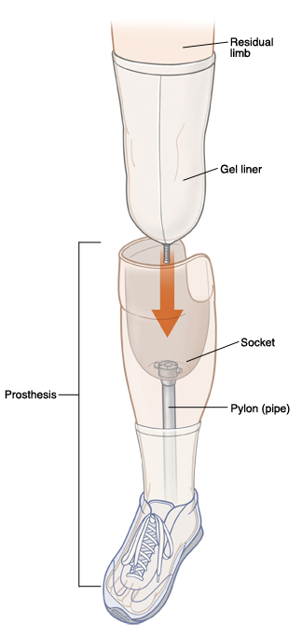
Benefits compared to socket prosthesis
Increased range of motion
Elimination of sores and pain
Stable and easy attachment/
detachment
Increased sensory feedback
Can be worn all day
No socket adjustments
Implanted Prosthetic (above) (Chalmers University of Technology, B., 2014)
Socket Prosthetic, 2015
Notes:
Increased range of motion since there are no physical limitations by the socket – the patient can move the remaining joints freely
Elimination of sores and pain caused by the constant pressure from the socket
Stable and easy attachment/detachment
Increased sensory feedback due to the direct transmission of forces and vibrations to the bone (osseoperception)
The prosthesis can be worn all day, every day
No socket adjustments required (there is no socket)

Slide 18
Benefits of implanting electrodes
Can control the prosthesis with less effort and more precisely
Prevents cross-talk
Increased motor signals
After fitting, little or no recalibration needed
Control not affected by environmental conditions
Bidirectional signals
Notes:
Due to the intimate connection, the patients can control the prosthesis with less effort and more precisely, and can thus handle smaller and more delicate items.
The close proximity between source and electrode also prevents activity from other muscles from interfering (cross-talk), so that the patient can move the arm to any position and still maintain control of the prosthesis.
More motor signals can be obtained from muscles and nerves, so that more movements can be intuitively controlled in the prosthesis.
After the first fitting of the controller, little or no recalibration is required because there is no need to reposition the electrodes on every occasion the prosthesis is worn (as opposed to superficial electrodes).
Since the electrodes are implanted rather than placed over the skin, control is not affected by environmental conditions (cold and heat) that change the skin state, or by limb motions that displace the skin over the muscles. The control is also resilient to electromagnetic interference (noise from other electric devices or power lines) as the electrodes are shielded by the body itself.
Electrodes in the nerves can be used to send signals to the brain as sensations coming from the prostheses.

Slide 19
Collaborative Thinking
Connect two or more brain together for decision making
In 2013 two mice connected via internet (Pais-Vieira et al., 2013)
In 2014 “two participants had to carry out a specific task in the form of a series of consecutive trials of a computer game” (Roa et al., 2014)
In 2014 “demonstrate the feasibility of direct brain-to-brain communication” (Grau et al., 2014)
“streams of pseudo-random bits representing the words “hola” and “ciao””
Notes:
Recent research has focused on the possibility of using BCI to connect different brains together directly with the aim to have collaborative decision making.
Researchers at Duke University in Durham, North Carolina, and the other in Natal, Brazil reported they connected the brains of two mice over the Internet, where the mice in different countries were able to cooperate to perform simple tasks together to obtain a reward (Pais-Vieira et al., 2013). Trained to press a level when a light went on above it. When task done correctly reward of water. One rat in room with light and lever and the other in a room with level. 70% success rate.
In another test the rats to decide wide or narrow spaces.
“experiments involving six different subjects” (Roa et al., 2014). Similar to the experiment performed by the mice, “two participants had to carry out a specific task in the form of a series of consecutive trials of a computer game” (Roa et al., 2014) and the game required cooperation as one of the subjects was the sender able to see the game but had no input to control it and the second as the receiver had an input device to interact with the game but could not see the screen.
This research involved having four human subjects with one assigned to be an emitter who would give orders and the other three would be recipients who receive messages. The overall goal of these experiments was to see if communication could go beyond verbal. These experiments showed that “streams of pseudo-random bits representing the words “hola” and “ciao” were successfully transmitted mind-to-mind between human subjects separated by a great distance, with a negligible probability of this happening by chance”(Grau et al., 2014).

Slide 20
References
Mak, J. and Wolpaw, J. (2009). Clinical Applications of Brain-Computer Interfaces: Current State and Future Prospects. IEEE Reviews in Biomedical Engineering, 2, pp.187-199.
Wolpaw, J., Birbaumer, N., McFarland, D., Pfurtscheller, G. and Vaughan, T. (2002). Brain–computer interfaces for communication and control. Clinical Neurophysiology, 113(6), pp.767-791.
Dobelle, W. (2000). Artificial Vision for the Blind by Connecting a Television Camera to the Visual Cortex. ASAIO Journal, 46(1), pp.3-9.
Birbaumer, N., Murguialday, A. and Cohen, L. (2008). Brain–computer interface in paralysis.Current Opinion in Neurology, 21(6), pp.634-638.
Pfurtscheller, G., Müller, G., Pfurtscheller, J., Gerner, H. and Rupp, R. (2003). ‘Thought’ – control of functional electrical stimulation to restore hand grasp in a patient with tetraplegia. Neuroscience Letters, 351(1), pp.33-36.
Chalmers University of Technology, A. (2014). Retrieved from Chalmers University of Technology. http://www.chalmers.se/SiteCollectionImages/20140701-20141231/Armprotesen-690-x-330.jpg
Chalmers University of Technology, B. (2014). Retrieved from Chalmers University of Technology http://media01.versus.io/00-blog-pics/00-post_header/Mind%20Control%20Arm%20Main%20Image.jpg
Chalmers University of Technology, C. (2014). Retrieved from Chalmers University of Technology http://www.chalmers.se/SiteCollectionImages/AUTUMN%202012/Max-Ortiz-robotarm.jpg
Socket Prosthetic (2015) Retrieved from https://www.fairview.org/fv/groups/public/documents/images/104745.jpg
Pais-Vieira, M., Lebedev, M., Kunicki, C., Wang, J. and Nicolelis, M. (2013). A Brain-to-Brain Interface for Real-Time Sharing of Sensorimotor Information. Scientific Reports, 3.
Rao, R., Stocco, A., Bryan, M., Sarma, D., Youngquist, T., Wu, J. and Prat, C. (2014). A Direct Brain-to-Brain Interface in Humans. PLoS ONE, 9(11), p.e111332.
Grau, C., Ginhoux, R., Riera, A., Nguyen, T., Chauvat, H., Berg, M., Amengual, J., Pascual-Leone, A. and Ruffini, G. (2014). Conscious Brain-to-Brain Communication in Humans Using Non-Invasive Technologies. PLoS ONE, 9(8), p.e105225.

